Slide 1
Virtualization Using Docker Containers: For creating reproducible environments and containerized applications
IA 697 Starred paper proposal
Srinath Reddy Meadusani
Committee members
Dr. Susantha Herath, Chair
Dr. Ezzat Kirmani
Dr. Kasi Balasubramanian
Spring 2018
03/16/2018
Notes:
Add NSF logo

Slide 2
Contents
Problem Statement
Introduction
Docker Features
Setting Up the Environment
Scaling the website using Swarm mode
Docker Security
Conclusion and Future Work
References

Slide 3
1. Problem Statement
In today’s competitive environment using the available resources efficiently has become imperative for IT organizations.
The traditional virtualization techniques which are being used in past years, has shown some degradation in the performance of applications which are deployed on those virtual machines.
Data center size of these organizations have also been increasing because of these obsolete virtualizations techniques.

Slide 4
2. Introduction
In the history of computing Containers have unique recognition because of its importance in virtualization of infrastructure.
Containers run the user space on top of the operating system kernel unlike traditional Hypervisor virtualization where one or more independent machines run virtually on physical hardware via an intermediate layer
Docker is an open-source engine which was introduced by Docker Inc in 2013 under apache 2.0 license to create light weight containers.

Slide 5
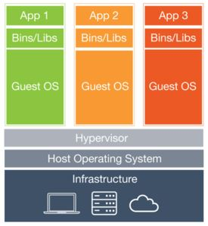
Continued…
Figure 1. Virtualization Using Virtual Machines (Wang, 2106)

Slide 6
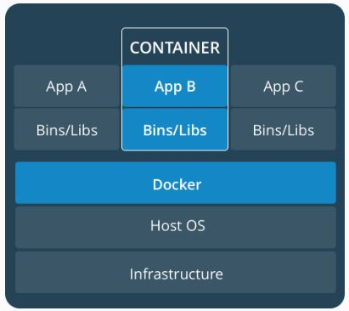
Continued…
Figure 3 Containerization using Dockers

Slide 7
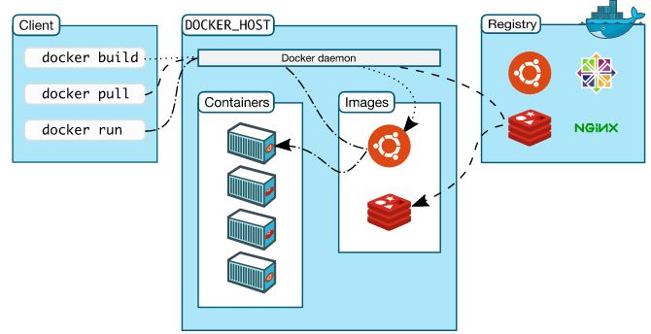
Continued…
Docker Architecture

Slide 8
Expected Outcomes
By the end of this study the paper answers the following questions:
Why there is a need for virtualization of infrastructure in an organization?
What are the problems with existing virtualization techniques?
Why there is a need to use containerized virtualization?
How did these containers solve the overheads of an organization?
How secure and compatible are these Containers?

Slide 9
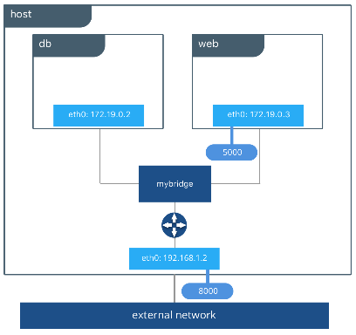
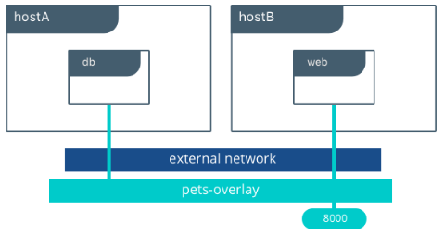
3. Docker Features
Networking: Bridge, Overlay, Host and Macvlan Networking drivers
Bridge Network
Overlay Network

Slide 10
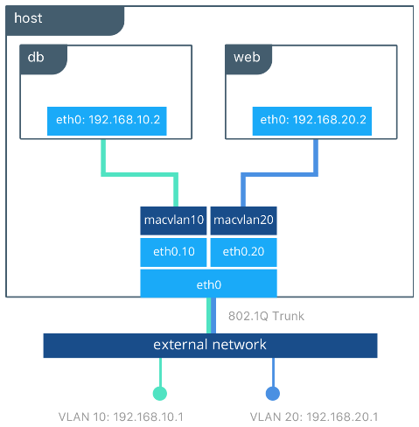
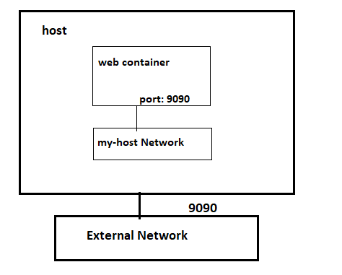
Networking Continued….
Host Network
Macvlan Network

Slide 11
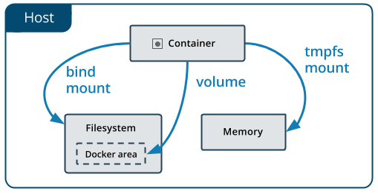
Docker Storage
Volumes, bind mounts and tmpfs to mount the data into the container from the host.
Containers Storage

Slide 12
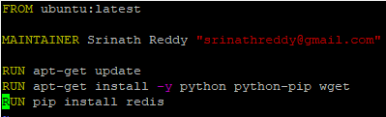
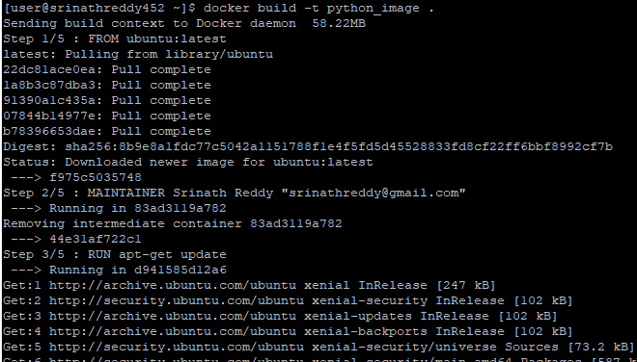
Dockerfile
Infrastructure as a code
Image Creation from Dockerfile

Slide 13
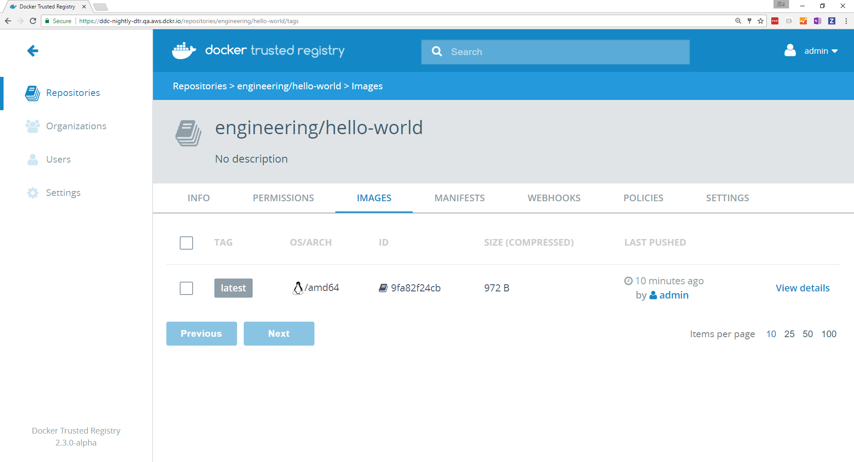
Docker Trusted Registry(DTR)
Web Interface for DTR

Slide 14
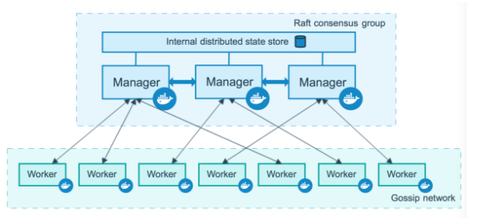
Docker Swarm
Orchestration System For Docker
Containerization in swarm mode

Slide 15
Docker Compose
Application needs more than one container which are isolated.
Useful in Dev and QA environments which reduces the overhead of maintaining and monitoring the infrastructure.
Docker-compose.yml contains the instructions which are written in YAML (Yet Another Markup Language or YAML Ain’t Markup Language) to spin up our Dev / QA environments

Slide 16
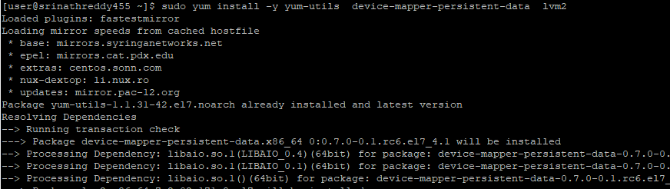
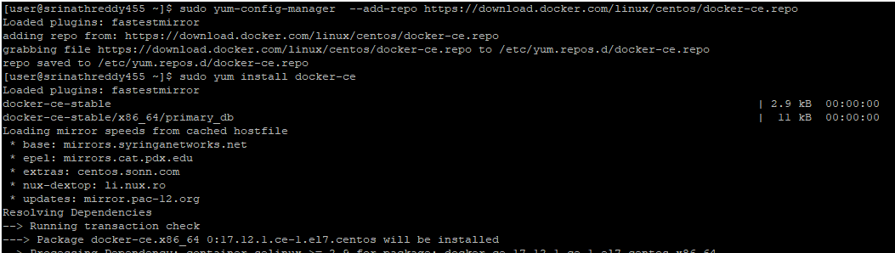
4. Setting Up the Environment
Install Docker Engine
Installing Docker Engine

Slide 17
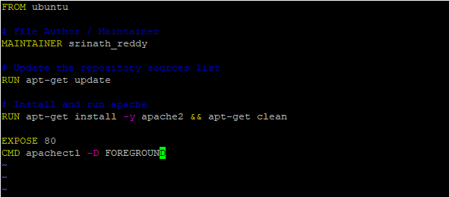
Continued…
Spinning up an apache-based web container and exposing it to outside world
Dockerfile for apache webserver

Slide 18
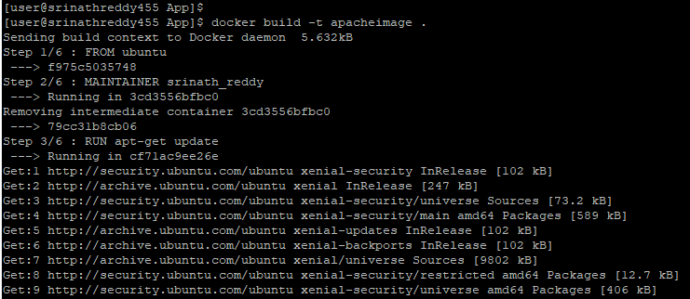
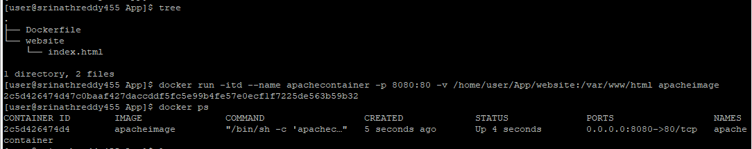
Continued…
Building the Apache Image from Dockerfile
Running the container out of Apache Image

Slide 19
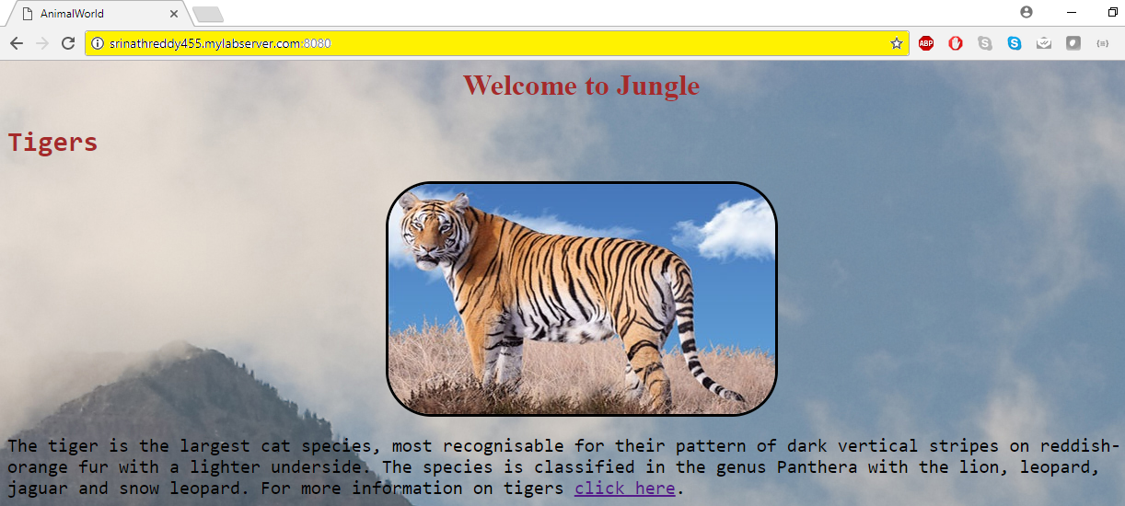
Continued…
Accessing the website using hostname

Slide 20
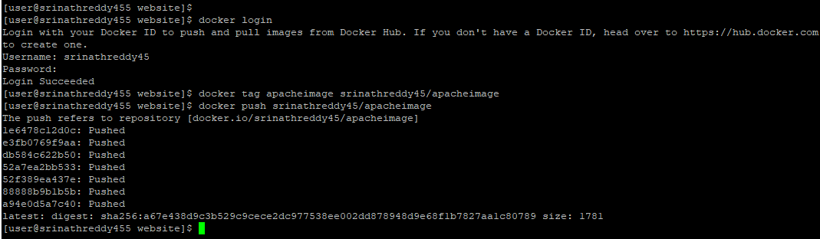
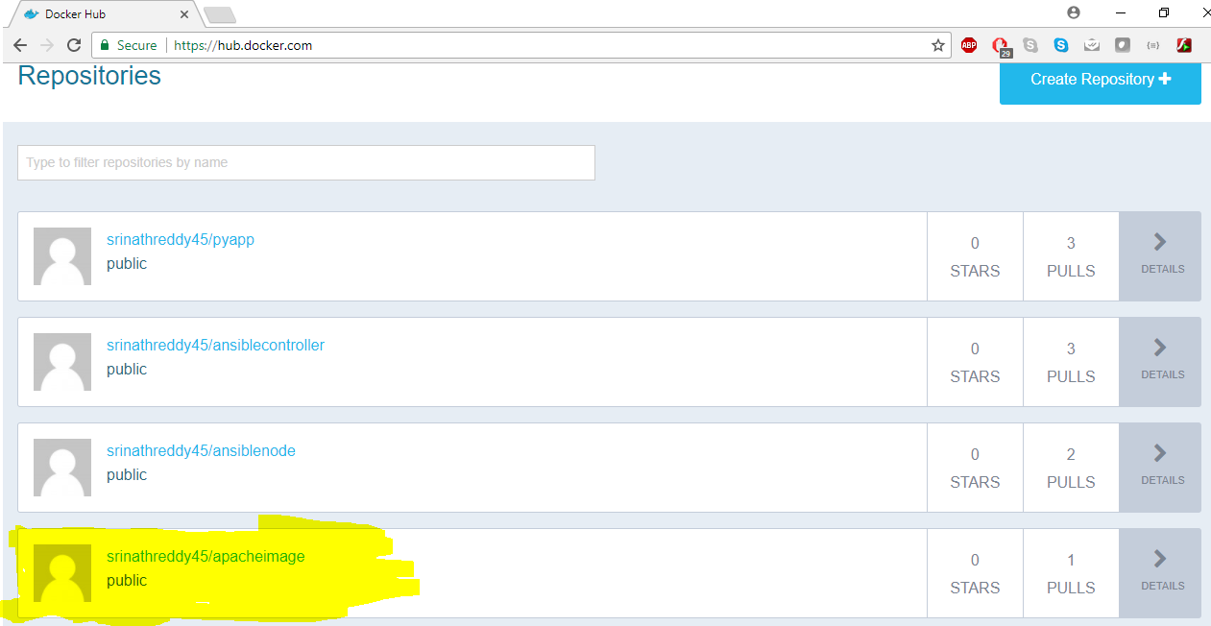
Continued…..
Pushing the image to Docker hub
Verifying the push on Docker hub

Slide 21
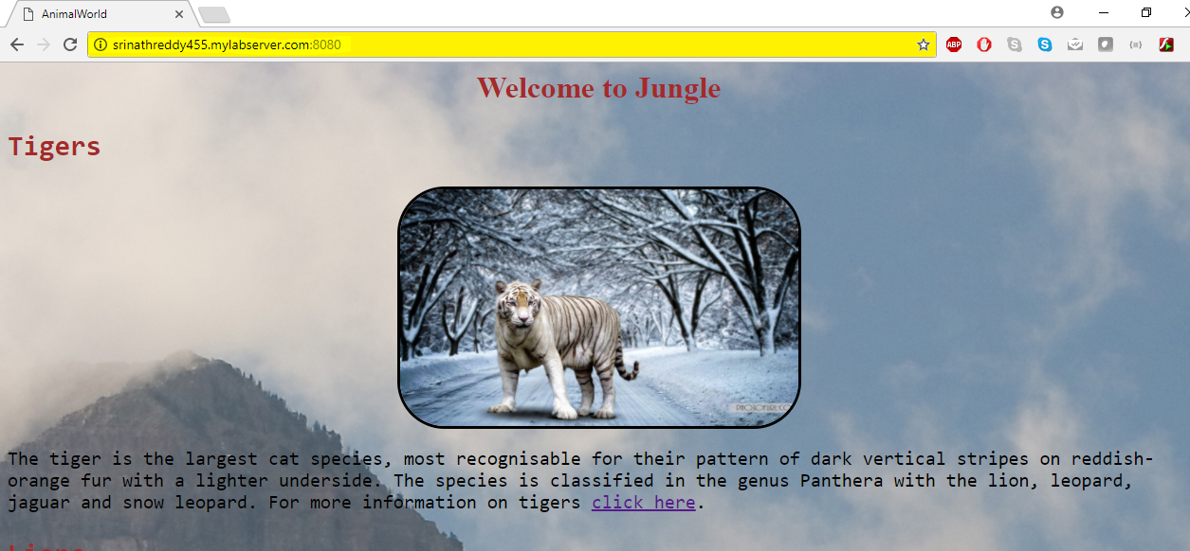
Continued….
Updated Web content

Slide 22
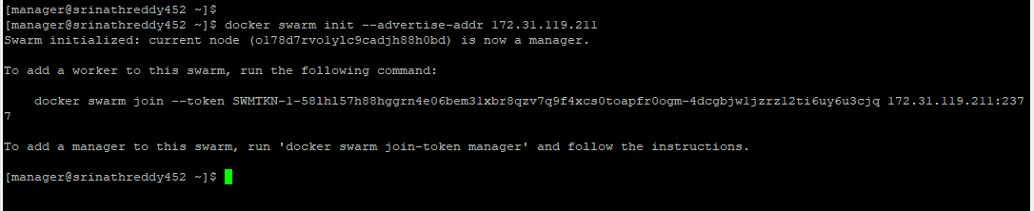
5. Scaling the website using Docker Swarm
Hostname | Role
srinathreddy452.mylabserver.com | Manager
srinathreddy453.mylabserver.com | Worker1
srinathreddy454.mylabserver.com | Worker2
Manager and Worker nodes
Initializing the swarm on manager node

Slide 23
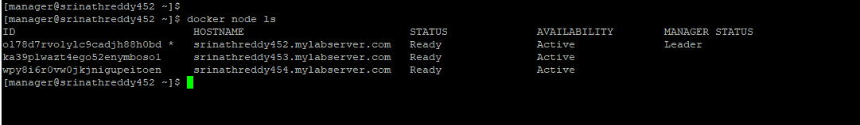
Continued……
Joining worker1 to Swarm
Joining worker2 to Swarm
Verifying nodes status

Slide 24
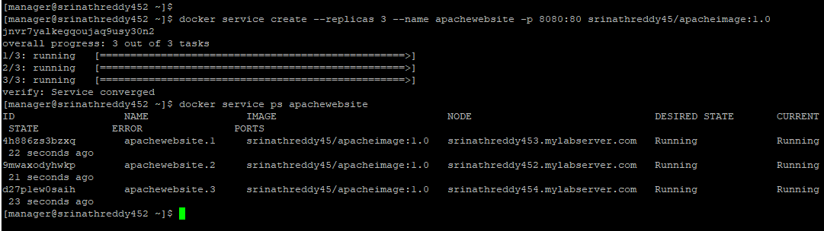
Continued……
Creating the service on our swarm

Slide 25
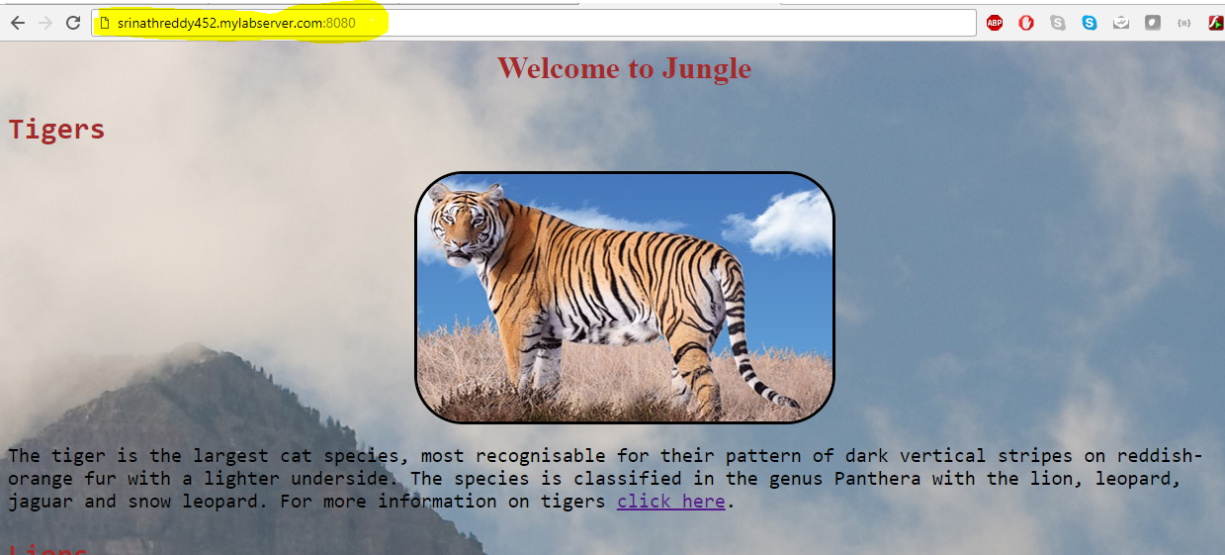
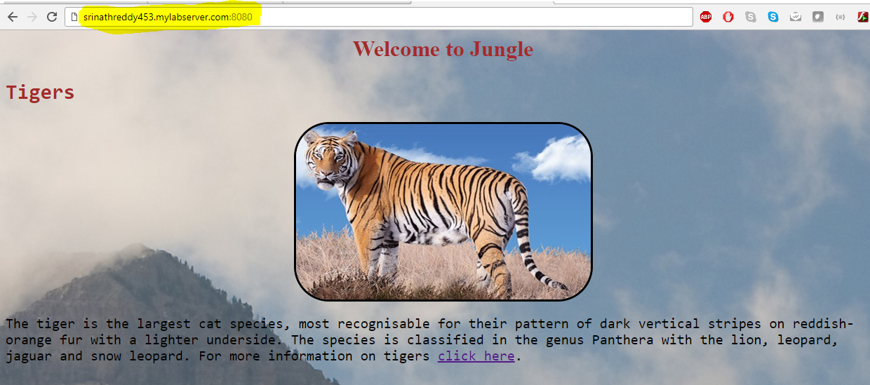
Continued……
Accessing the website using Manger node hostname
Accessing the website using worker1 node hostname

Slide 26
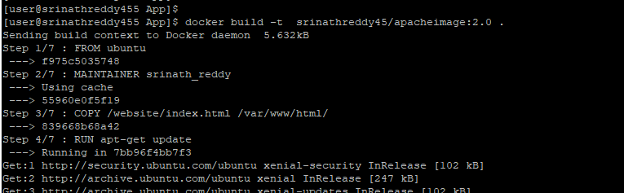
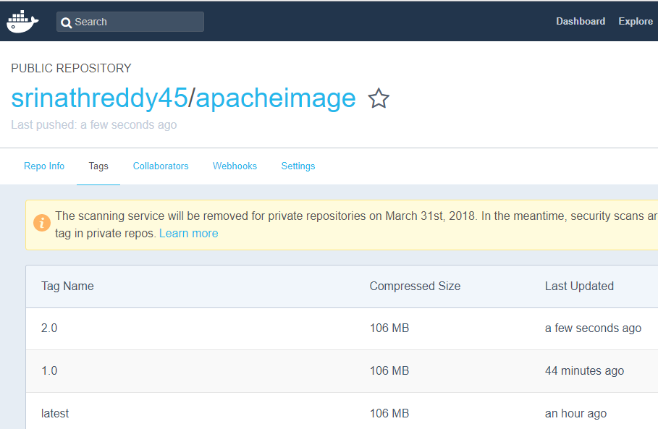
Updating the Content on Website
Building the updated image
Verifying the updated image on Docker hub

Slide 27
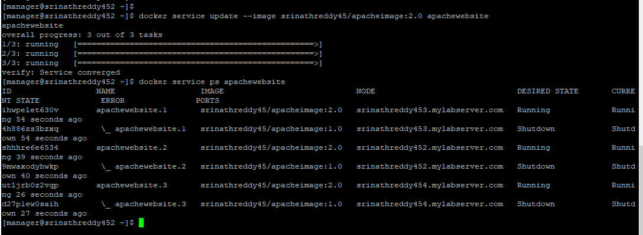
Continued……
Rolling update of image on all the containers

Slide 28
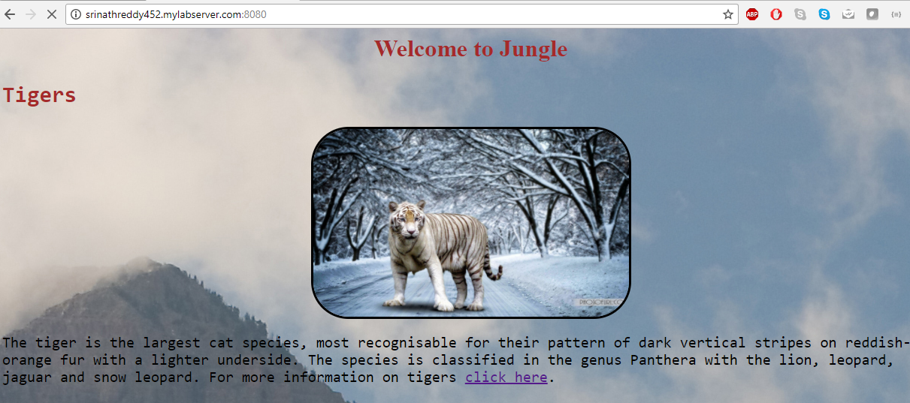

Continued……
Accessing the updated website using Manger node hostname
Accessing the updated website using worker2 node hostname

Slide 29
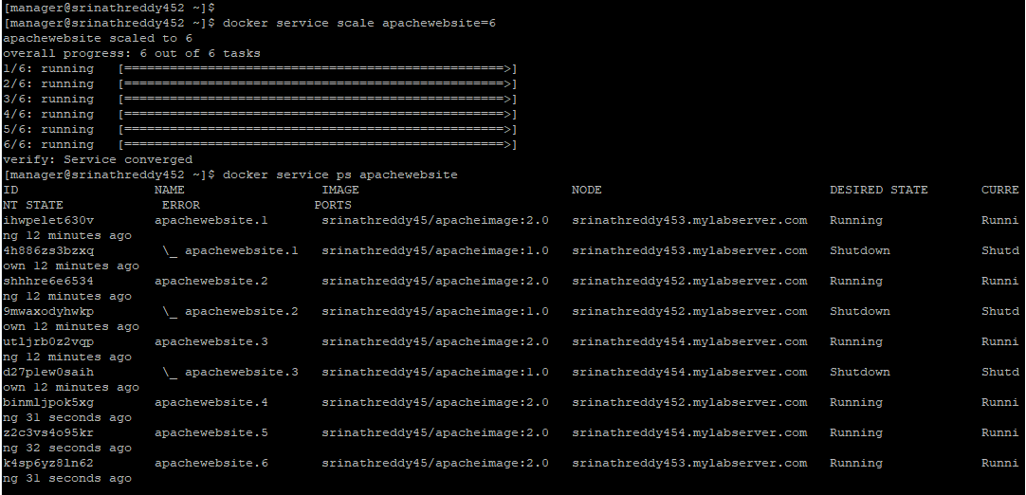
Continued……
Scaling the number of containers hosting our website

Slide 30
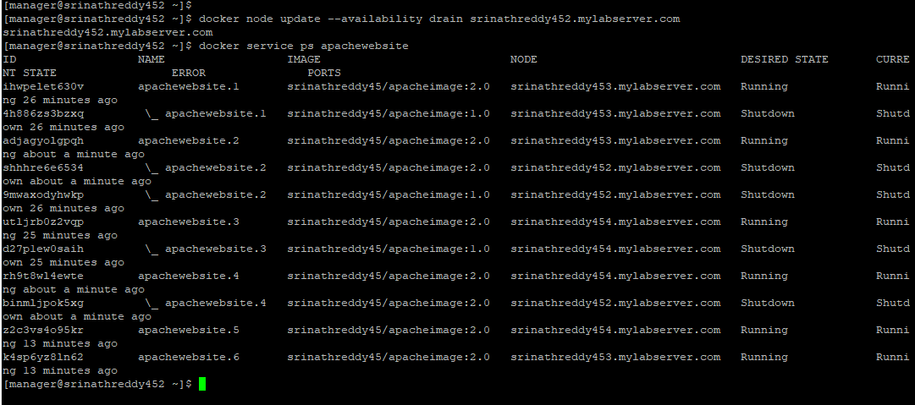
Continued……
Draining a node
Verifying nodes status

Slide 31
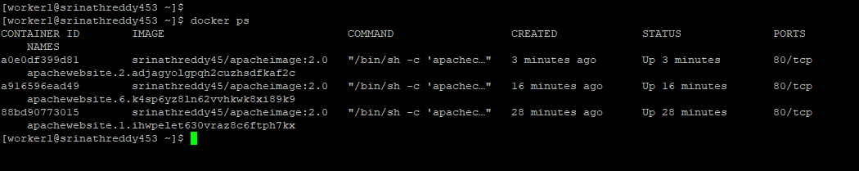
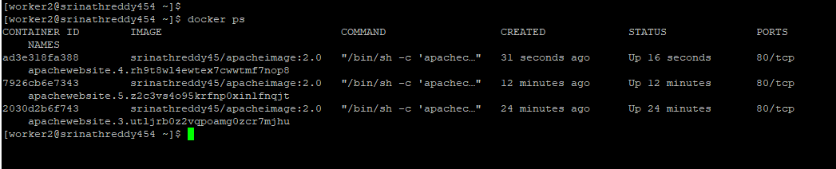
Continued……
Verifying capacity on worker1
Verifying capacity on worker2

Slide 32
6. Docker Security
Risk of privilege escalation is very high when using containers
Needs to careful while using images from public repositories
Denial of Service(DoS) attack, where one compromised container can seize the operability of other containers by denying the host system resources to other containers

Slide 33
7. Conclusion
Docker containers have made application lifecycle development easy in all the environments such as develop, test and production.
Docker can be used to reproduce the environments on our local desktops or remote servers within no time to test and deploy our application.
Application downtime can be decreased by scaling up the number of containers within no time where the application is hosted in those containers

Slide 34
Future Work
Automating the creation of containers using scripts and several other automation tools such as Jenkins.
Implement the containers on several other public cloud providers such as Amazon AWS, Microsoft Azure and Google’s GCP and comparing their performances
Work on several other third-party cluster management tools such as Apache Mesos and Kubernetes which are much more sophisticated and advanced.

Slide 35
8. References
[1]. Ryan Chamberlain, Jennifer Schommer: “Using Docker to Support Reproducible Research”, 2014.
[2]. Chao Zheng, Douglas Thain: “Integrating containers into workflows: A case study using Makeflow, Work Queue and Docker”, 2015.
[3]. Carl Boettiger: “An introduction to Docker Reproducible Research with Examples from R Environment”, 2014.
[4]. Charles Anderson: “Docker in Software Engineering”, 2015.
[5]. Salman Basnet, Stefan Berger: “IBM Research Report on Docker and Container security”, 2016.
[6]. James Turnbull: “The Docker Book”, 2014.

Slide 36
References( Cont…)
[7] Shrikrishna Holla: “Orchestrating Docker: Manage and Deploy Docker services to containerize applications efficiently”, 2015.
[8]. Guo P. CDE: “A Tool for Creating Portable Experimental Software Packages using Docker”, 2012.
[9]. LeVeque R, Mitchell I: “Reproducible Research for Scientific Computing: Tools and Strategies for Changing the Culture”, 2012.
[10]. Altintas, C. Berkley: “An extensible system for design and execution of scientific workflows in Scientific and Statistical Database Management”, 2004.

Slide 37
References(Cont..)
[11]. Wang, Chenxi. (2016). Containers 101: Linux containers and Docker explained. Retrieved from http://www.infoworld.com/article/3072929/linux/containers-101-linux-containers-and-docker-explained.html
[12]. What are containers. (2015). Retrieved from https://www.sdxcentral.com/cloud/containers/definitions/what-are-containers-like-docker-linux-containers/
[13]. M. Rosenblum, T. Garnkel: “Virtual machine monitors: Current technology and future trends”, Computer, 2005.
[14]. Docker overview. (2016). Retrieved from Official docs: https://docs.docker.com/engine/docker-overview/

Slide 38


Slide 39


